Slide 1
office systems and technology
Chapter 3
Telecommunications and Network Technologies

Slide 2
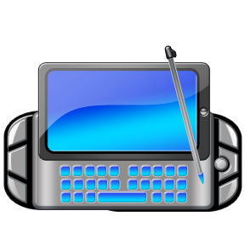
Overview
Communications is the exchange of internal and external messages (both written and verbal) that forms the basis for all office interaction.
Telecommunications is the exchange of voice, data, text, graphics, or audio and video information over computer-based networks.
Notes:
Page 1

Slide 3
A. Telecommunications Components and Functions
Telecommunications Industry
  Deregulated in 1984 by Justice Dept. – allowed competition in the selling of telecom services and equipment
  In 1996 – Telecommunications Deregulation and Reform Act widened deregulation by freeing telephone companies, broadcasters and cable companies to enter each other’s markets
Notes:
Page 52

Slide 4
A. Telecommunications Components and Functions (cont’d)
        Telecommunications Software and Hardware – telecommunication system is a collection of software and hardware for transmitting information between diverse locations
          Software controls the entire transmission process including:
            Establishing an interface between sender/receiver
            Routing messages
            Ensuring that the right message is sent to the correct receiver
            Performing editorial checks for transmission errors
            Converting message speeds and formats
Notes:
Page 52

Slide 5
A. Telecommunications Components and Functions (cont’d)
      Hardware – telecom hardware supports the data transmission and reception includes several types of processors and a network interface card (NIC)
        Processors = devices necessary for the communication function
          Five telecommunications processors
          Modem – device that converts digital data codes into analog signals; two modems are always required for computers to communicate; one at sending MOdulates the digital data; DEModulated when data reaches the receiving location
          Front-end processor – small, specialized computer that communicates with the main computer system and manages routine tasks
Notes:
PAGE 52

Slide 6
A. Telecommunications Components and Functions (cont’d)
          3. Multiplexer – allows one communication channel to carry data from multiple sources at the same time; needed at both the receiving and sending locations
          4. Bridge – communication processor that provides a connection between two similar networks
          5. Gateway – communication processor needed to connect two dissimilar networks; translates the differences between the two systems so the computers can communicate with one another
          Network Interface card (NIC)– an expansion card that connects the microcomputer to a network enabling the exchange of data between computers
Notes:
Page 52

Slide 7
A. Telecommunications Components and Functions (cont’d)
  Telecommunication Channels:
    Analog transmission signals = voice transmission; Digital transmission signals = data transmission
    Three types of line channels:
      1) twisted wire; 2) coaxial cable; 3) fiber optics
      Wireless transmission includes microwave, satellite and radio technologies
      Twisted wire – relatively slow and transmission interference
    Digital subscriber line = DSL – high capacity digital transmission over twisted copper lines; not used between telephone switching stations
    T-1 Line = dedicated line consisting of 24 individual channels used by Internet Service Providers (leased or purchased from telephone companies)
    T-3 Line = dedicated service line consists of 672 individual channels; mainly used by ISPs connecting to the Internet backbone
    Coaxial cable – thickly insulated copper wire for fast data transmission; minimizes wire tapping = broadband for digital transmission
Notes:
PAGE 53 & 54 – look at Fig. 3-2 – Page 54

Slide 8
A. Telecommunications Components and Functions (cont’d)
    Fiber optic cable = thousands of fine glass fibers used to transmit light beams (laser technology); faster and more durable than copper wire; transmission rates are 640 times greater than coaxial cable!
    Provides greater security from tapping
    Wireless channels – rely on low-power radio frequencies or infrared technology to transmit digital communications
    channels include microwave, satellites, wireless networks, Bluetooth, and cellular
    * microwave = earthbound system and transmission is point-to-point in a straight line; microwave antennas on tops of towers; spaced about 30 miles apart
Notes:
Page 290

Slide 9
A. Telecommunications Components and Functions (cont’d)
    Satellite communication systems are placed in orbit to accept (uplink) and retransmit (downlink) transmission signals
      Cost effective for very large quantities of data over very long distances
    Wireless local-area networks (LAN) – solution for short-distance connections via low-frequency radio technology or infrared technology
      Infrared technology uses infrared light beams to establish the communication links among computers in the network
    Bluetooth – uses radio technology and transmits data around corners and through objects; not a line of sight channel
    Cellular – devices are equipped with radio technology for transmission of voice and data
Notes:
Pg. 56 – Check Point AAAAAA!!!

Slide 10

B. Telephone Communications
Telephone Services
  Basic services – flat rate or measured unit
    Local call
    Direct distance dialing (no operator!)
    Person-to-person – operator assisted call where charge is only incurred if the person being called comes to the phone
    Collect call – operator assisted; paid for by receiving company or person
    Card call – charged to a credit card
    Message unit – standard base rate used to determine charge
Notes:
Pg. 57 - 58

Slide 11

B. Telephone Communications (cont’d)
    Directory assistance
    Audio conference
    Emergency 911 calls
    Text telephones – accommodates disabilities
    Cell phones
    Camera phones
    Marine calls
    International calls – operator assisted; now, using the computer (Internet phone) just requires audio software and speakers
    WATS – fixed monthly fee paid for WATS hours

Slide 12
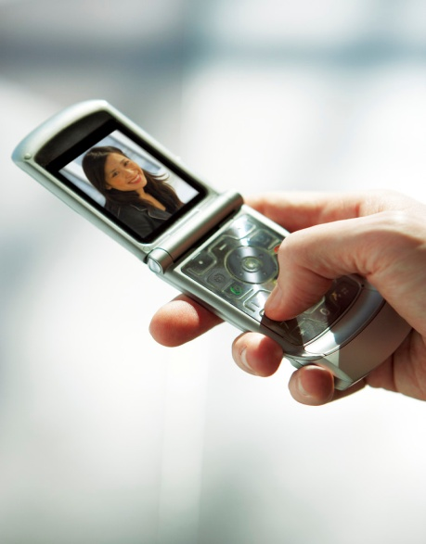
B. Telephone Communications (cont’d)
    INWATS – inward wide area telephone service: subscription service available for companies if numerous telephone calls are expected from customers – toll-free calls!
    Foreign exchange – provides customers a local number when calling a business located in another city
    Answering services – used by doctors’ offices
    Special Telephone Features
      Call waiting
      Call forwarding
      Caller ID
      Redialing
      Call Trace - *57 or *69
Notes:
Pg. 60

Slide 13
B. Telephone Communications (cont’d)
  Telephone Systems
    Private Branch Exchanges (PBX)
      Special purpose computer – now accepts voice and data transmissions for smaller organizations
    Computerized Branch Exchange (CBX)
      Computer-based telephone communication system
      Only serves telephone requirements!
    Central Exchange Systems (CENTREX) – TELECOM!
      Usually leased from the regional telephone company
      Seven digit numbers
Notes:
Page 61

Slide 14

B. Telephone Communications (cont’d)
  Telephone Equipment
    Touch-tone
    Speakerphone
    Call director – desktop unit that can handle 100 lines
    Paging system – in-house communication system
    Headset – ergonomically designed; hands-free
      Common peripheral to cellular phones!
Notes:
Check Point BBBBB! Page 63

Slide 15
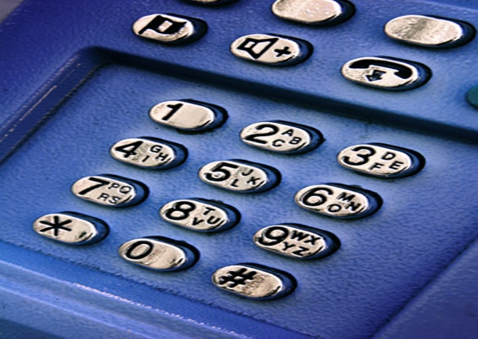
C. Communication Networks
Communication in a computer environment transmits:
  Documents
  Graphics
  Images
  Files
  Sender, receiver and communication channel
  Data need to be converted into digital information called bits (digitizing)

Slide 16
C. Communication Networks (cont’d)
  Computing Models
    Three computing models today:
      Centralized Computing – data were processed in large centralized computers with users entering data from local input devices
      Distributed Computing – requires networks so information and services could be easily shared between distributed environments
        Peer-to-Peer = puts all processing power on the user’s desktop PC; computers work together without any central controlling authority
        Client/server computing = uses a microcomputer, mide-range computer or mainframe as a server to its clients
          Thin client – server may handle all functions with the client having only an interface to the server
      Collaborative Computing – emerged in the 1990s; network infrastructure support data, information and process sharing
Notes:
Pg. 65

Slide 17
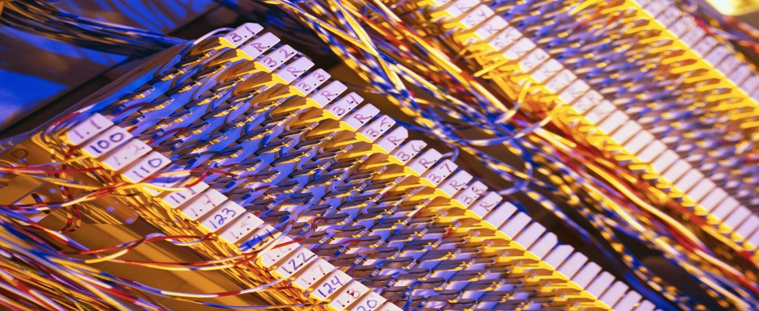
C. Communication Networks (cont’d)
  Network Categories
    Local Area Networks (LAN) – private network that supports communications within an office, building or firm
      LAN links electronic devices so that data can be shared easily and at greater speeds
    Wide Area Networks (WAN) – combination of private or public lines, microwave, or satellite transmission for long distance communications between two or more LANs
Notes:
Page 66

Slide 18
C. Communication Networks (cont’d)
      Five Categories of WANS
        Enterprise Network – connects distributed networks of a single organization
        Metropolitan Area Network (MAN) – limited to a small geographic area
        Global Network – Internet is the world’s largest computer network (ON TEST!!!!)
        Virtual Private Network (VPN) – used for intranet and extranet security; uses firewalls and other measures to establish a secure network when the Internet is the network backbone
        Value Added Network (VAN) – private multimedia, multipath, third-party managed, medium-speed WAN
          Economical because it is shared by multiple organizations
          Subscription fee
Notes:
Page 66

Slide 19
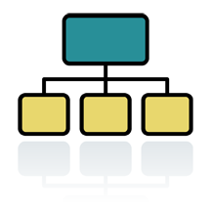

C. Communication Networks (cont’d)
  Network Topologies
    Three basic network structures are used in local area and wide-area telecommunications networks
      Bus configuration – attaches all peripheral devices
Notes:
Page 67 – Be sure to discuss Figure 3-4 Types of Network Topologies
Page 68 – Check Point C and FOR YOUR REVIEW

Slide 20
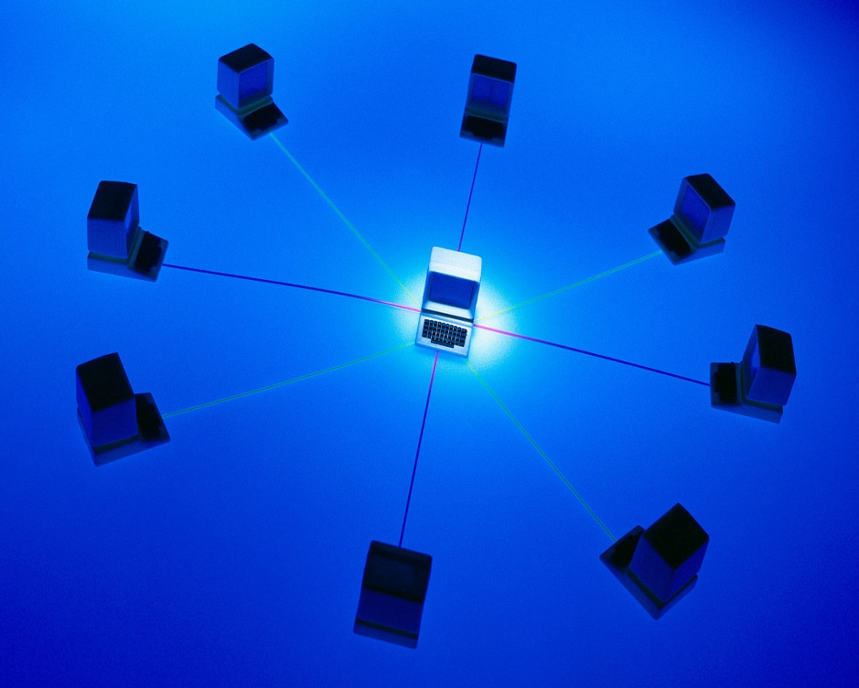
C. Communication Networks (cont’d)
      Star configuration – central computer required (central node)

Slide 21
C. Communication Networks (cont’d)
      Ring configuration – implemented to eliminate reliance on a central decision point for WANs
        A configuration is called network topology
        Star and ring topologies are common for WANs
        No matter what network topology is applied, local area networks are either a client/server or a peer-to-peer computing model

Slide 22

THE END!

